Slide 1
The Cell's Elastic Skin: How Membrane Physics Organize Biological Life
Pebble Summer School
2026.7.27
Jiahao Chen

Slide 2
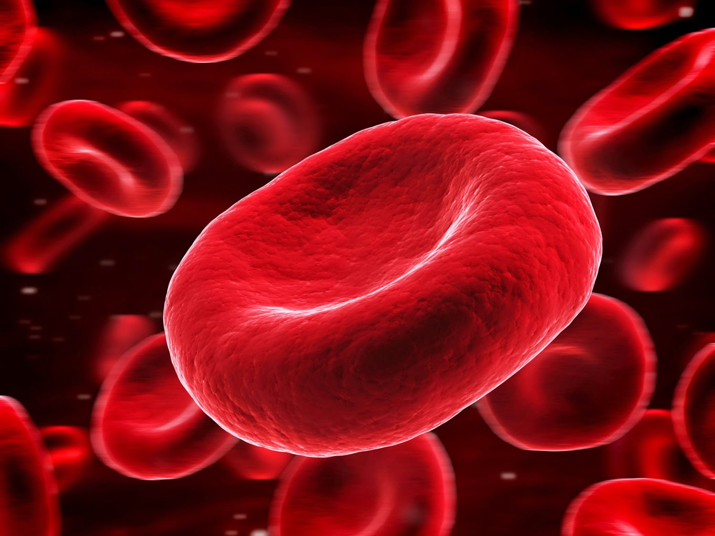
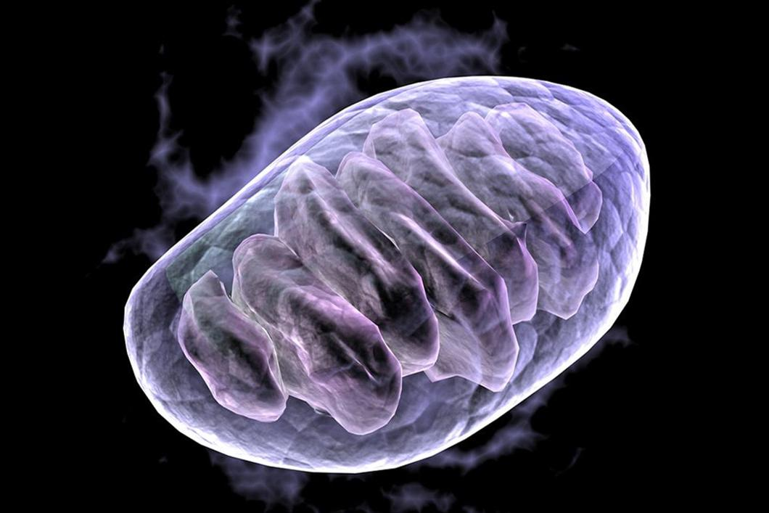
Biological Function & Physical Perspective
Central paradigm Membrane shape is intimately coupled to physiological function.
Biological illustrations
RBCs: Biconcave disc → optimizes gas exchange and deformability in capillaries.
Mitochondrial cristae: Highly folded inner membrane → maximizes ATP synthesis area.
Physical model Lipid bilayer treated as a two-dimensional fluid elastic sheet.
Shape determination Although biological cues (cytoskeleton, proteins) guide remodeling, equilibrium shapes are governed by free-energy minimization under geometric and physical constraints.

Slide 3
Historical Evolution & Theoretical Milestones
The Lipid Bilayer Hypothesis (1925): Gorter and Grendel first established that cell membranes consist of a bimolecular lipid layer.
Fluid Mosaic Model (1972): Singer and Nicolson conceptualized the membrane as a two-dimensional liquid matrix, establishing its fluid behavior within the plane alongside elastic resistance against out-of-plane bending.
The Canham-Helfrich Elastic Energy Model (1970–1973): Building upon early curvature energy concepts proposed by Peter Canham (1970), Wolfgang Helfrich (1973) formulated a rigorous Hamiltonian by applying differential geometry and liquid crystal physics.

Slide 4
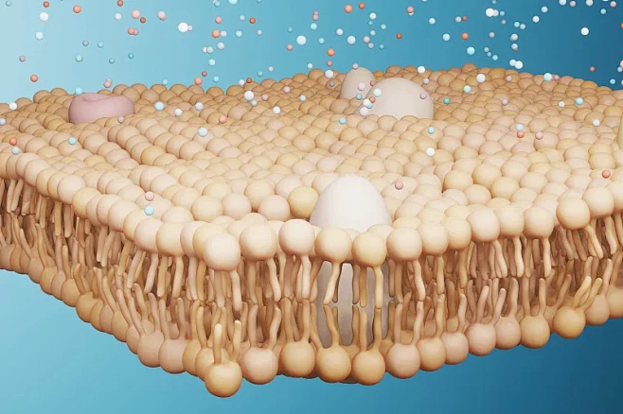
The Lipid Bilayer Hypothesis (1925)
Extracted lipids from RBCs → spread as monolayer.
Monolayer area ≈ 2× cell surface area.
Conclusion: membrane is a bilayer (two lipid layers back‑to‑back).
First direct evidence of membrane molecular structure.

Slide 5
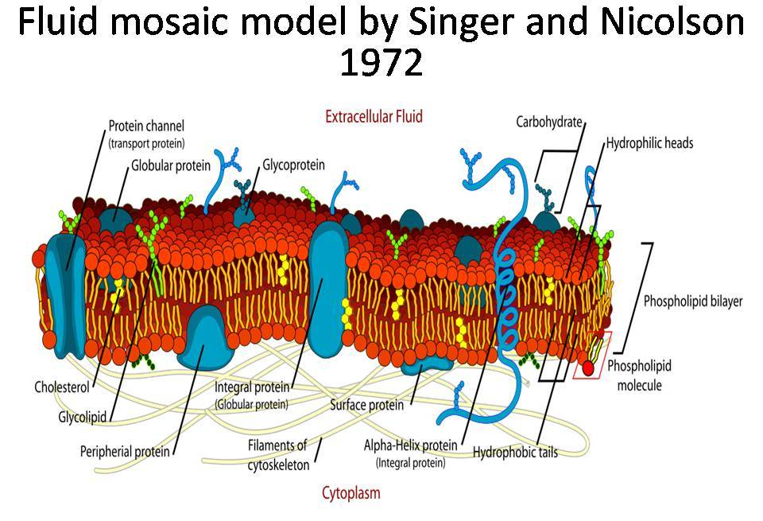
Fluid Mosaic Model (1972)
Redefined membrane as dynamic 2D fluid lipid matrix with embedded proteins.
Replaced rigid “protein–lipid–protein” sandwich model.
Two key features:
Fluidity: lipids & proteins diffuse laterally (liquid, not crystal).
Mosaicity: proteins are embedded (integral spanning, peripheral attached), not just coated.
Explained protein clustering, cell fusion, etc. — still the central paradigm.

Slide 6
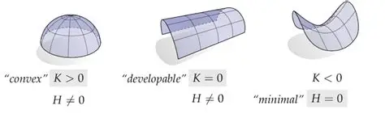
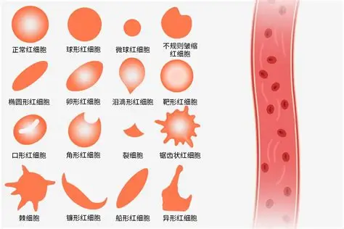
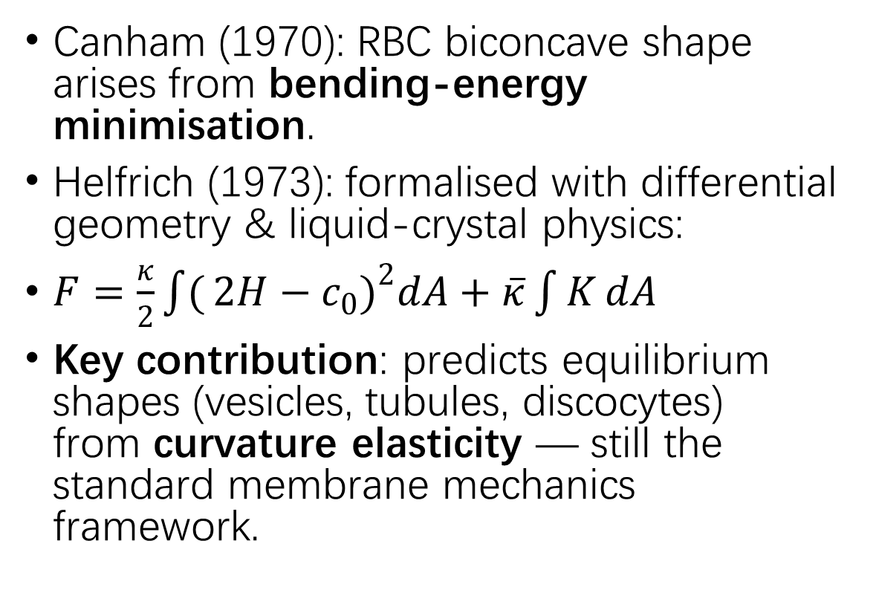
C-H Elastic Energy Model (1970–1973)
Canham (1970): RBC biconcave shape arises from bending‑energy minimisation.
Helfrich (1973): formalised with differential geometry & liquid‑crystal physics:
$F=\frac{κ}{2}\int{(}\left.2H−c_{0}{\left.)\right.}^{2}dA+\overline{κ}\int{K}dA\right.$
Key contribution: predicts equilibrium shapes (vesicles, tubules, discocytes) from curvature elasticity — still the standard membrane mechanics framework.

Slide 7
Basic Mathematical Setup: Differential Geometry of 2D Surfaces
Assume that the position vector of any point on the surface is expressed as r(u,v) ∈ ℝ³.
The square of the infinitesimal line element on the surface is given by the first fundamental form: I = dr · dr = E du² + 2F du dv + G dv²,
with coefficients defined as E = rᵤ · rᵤ, F = rᵤ · rᵥ, G = rᵥ · rᵥ.

Slide 8
Second Fundamental Form
The unit normal vector n at a given point on the surface is defined as n = ( rᵤ × rᵥ ) / | rᵤ × rᵥ |. The second fundamental form describes the extrinsic bending of the surface in three-dimensional space: II = – dr · dn = L du² + 2M du dv + N dv², with coefficients defined as L = rᵤᵤ · n, M = rᵤᵥ · n, N = rᵥᵥ · n.

Slide 9
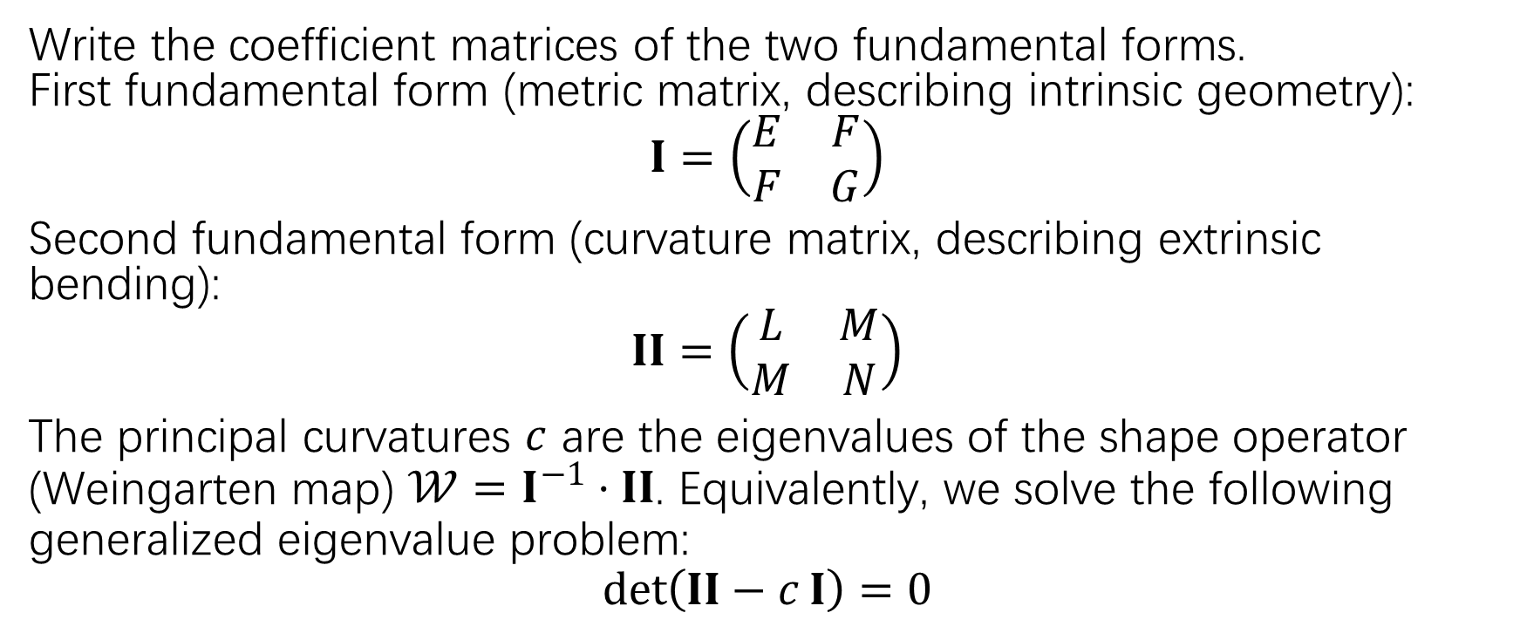
How to get principle curvature?
Write the coefficient matrices of the two fundamental forms. First fundamental form (metric matrix, describing intrinsic geometry):
$$I=\left(\begin{matrix}E & F \\ F & G\end{matrix}\right)$$
Second fundamental form (curvature matrix, describing extrinsic bending):
$$II=\left(\begin{matrix}L & M \\ M & N\end{matrix}\right)$$ The principal curvatures $c$ are the eigenvalues of the shape operator (Weingarten map) $𝒲=I^{−1}⋅II$. Equivalently, we solve the following generalized eigenvalue problem:
$$det⁡\left(II−c I\right)=0$$

Slide 10
Mean Curvature and Gaussian Curvature
From the principal curvatures, we derive the two most central geometric quantities in the Helfrich model:
Mean curvature (H): H = ½(c₁ + c₂) which reflects the average degree of bending of the surface (outward or inward).
Gaussian curvature (K): K = c₁ · c₂

Slide 11
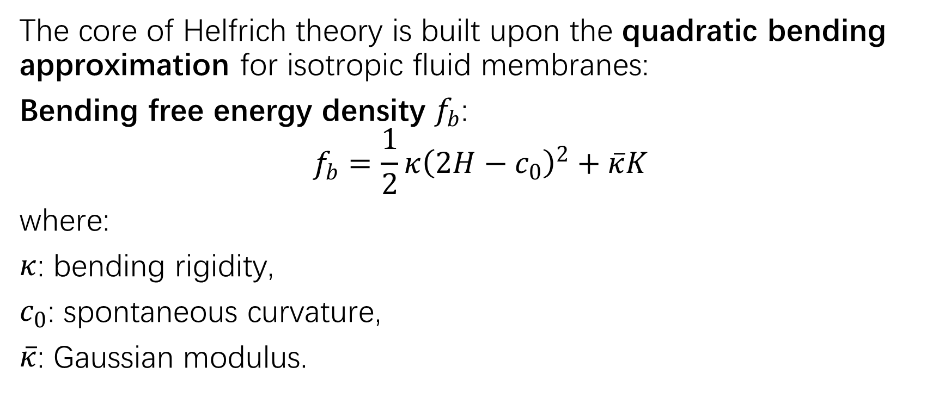
Helfrich Theory
The core of Helfrich theory is built upon the quadratic bending approximation for isotropic fluid membranes:
Bending free energy density $f_{b}$:
$$f_{b}=\frac{1}{2}κ{\left(2H−c_{0}\right)}^{2}+\overline{κ}K$$
where:
$κ$: bending rigidity,
$c_{0}$: spontaneous curvature,
$\overline{κ}$: Gaussian modulus.

Slide 12
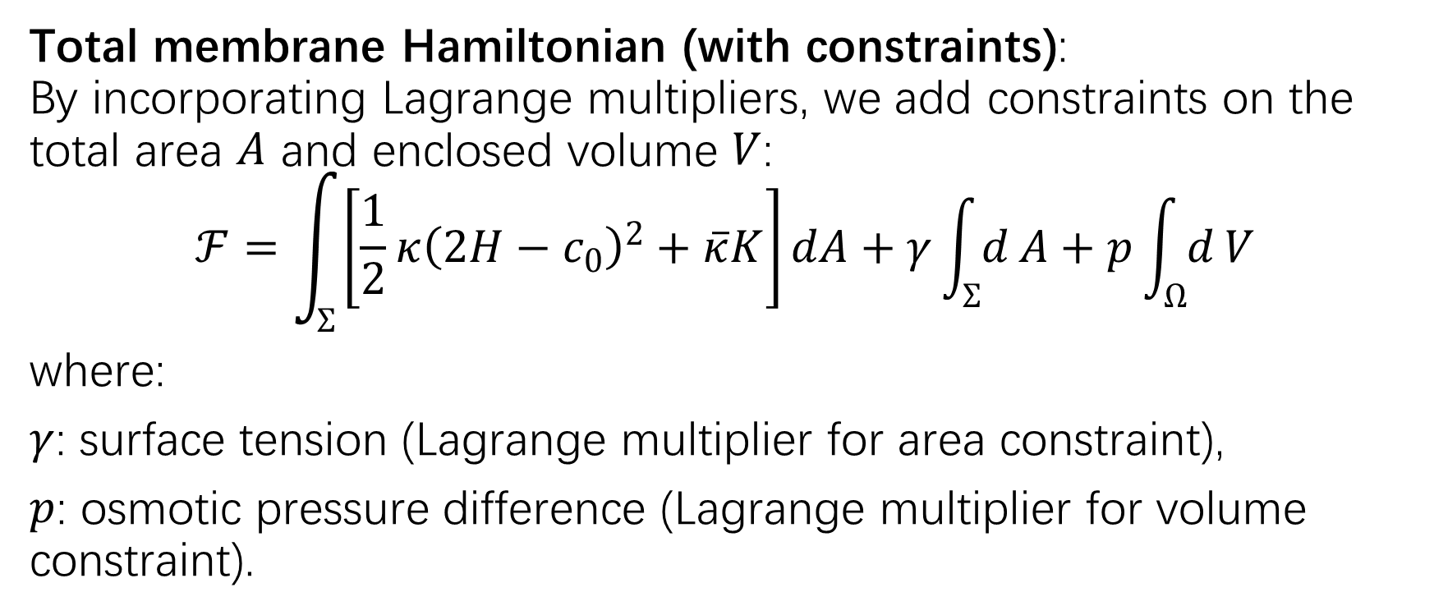
Helfrich Theory
Total membrane Hamiltonian (with constraints): By incorporating Lagrange multipliers, we add constraints on the total area $A$ and enclosed volume $V$:
$$ℱ=\int_{Σ}{\left[\frac{1}{2}κ{\left(2H−c_{0}\right)}^{2}+\overline{κ}K\right]}dA+γ\int_{Σ}{d}A+p\int_{Ω}{d}V$$
where:
$γ$: surface tension (Lagrange multiplier for area constraint),
$p$: osmotic pressure difference (Lagrange multiplier for volume constraint).

Slide 13
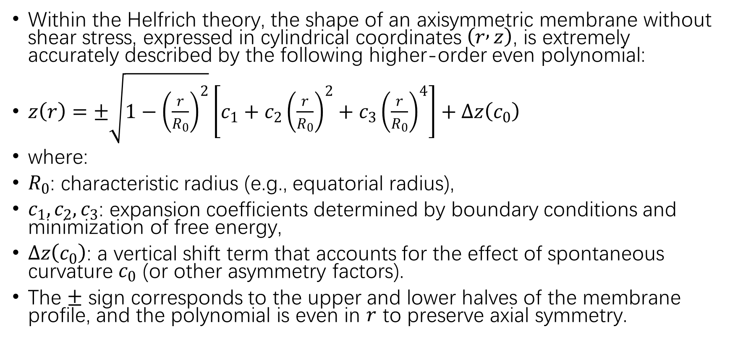
Visualization
Within the Helfrich theory, the shape of an axisymmetric membrane without shear stress, expressed in cylindrical coordinates $\left(r , z\right)$, is extremely accurately described by the following higher-order even polynomial:
$z\left(r\right)=±\sqrt{1−{\left(\frac{r}{R_{0}}\right)}^{2}}\left[c_{1}+c_{2}{\left(\frac{r}{R_{0}}\right)}^{2}+c_{3}{\left(\frac{r}{R_{0}}\right)}^{4}\right]+Δz\left(c_{0}\right)$
where:
$R_{0}$: characteristic radius (e.g., equatorial radius),
$c_{1},c_{2},c_{3}$: expansion coefficients determined by boundary conditions and minimization of free energy,
$Δz\left(c_{0}\right)$: a vertical shift term that accounts for the effect of spontaneous curvature $c_{0}$ (or other asymmetry factors).
The $±$ sign corresponds to the upper and lower halves of the membrane profile, and the polynomial is even in $r$ to preserve axial symmetry.

Slide 14
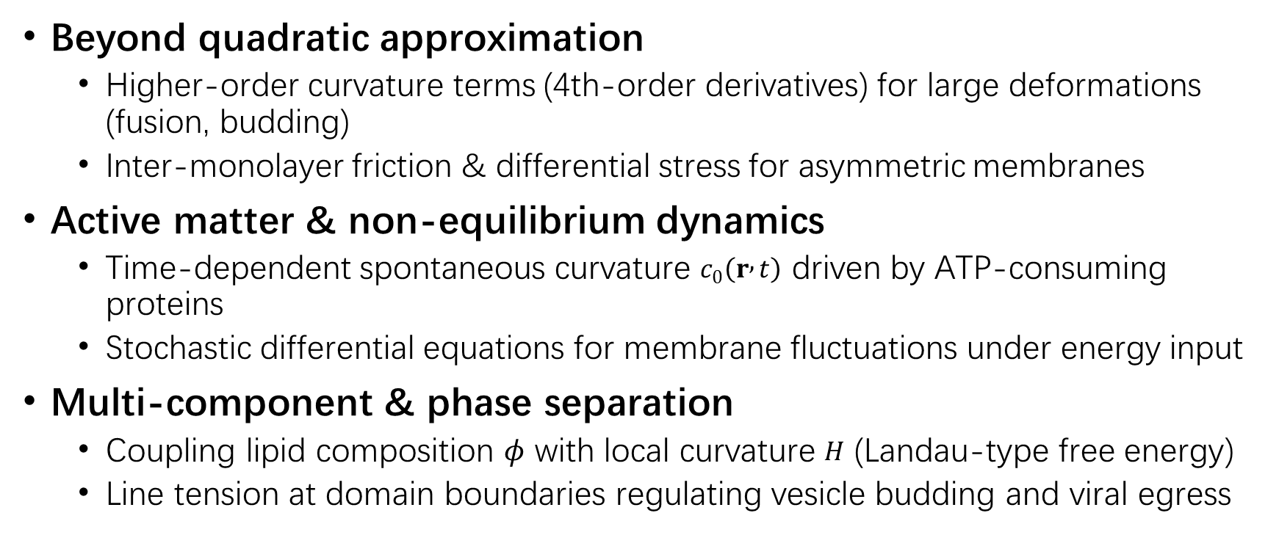
Future Directions – Theoretical & Physical Extensions
Beyond quadratic approximation
Higher-order curvature terms (4th-order derivatives) for large deformations (fusion, budding)
Inter-monolayer friction & differential stress for asymmetric membranes
Active matter & non-equilibrium dynamics
Time-dependent spontaneous curvature $c_{0}\left(r , t\right)$ driven by ATP-consuming proteins
Stochastic differential equations for membrane fluctuations under energy input
Multi-component & phase separation
Coupling lipid composition $φ$ with local curvature $H$ (Landau-type free energy)
Line tension at domain boundaries regulating vesicle budding and viral egress

Slide 15
Future Directions – Mechanics, Computation & Applications
Cytoskeleton-membrane composite
Nonlinear viscoelastic substrate coupling (actin cortex + lipid bilayer)
Mechanotransduction: membrane tension → protein conformation → gene expression
Multi-scale computation & AI
Coarse-grained MD coupled with continuum Helfrich theory (nm ↔ μm)
Physics-Informed Neural Networks (PINNs) to infer stiffness/protein forces from cryo-EM images
Clinical & synthetic biology applications
Designing optimal LNP (lipid nanoparticle) shapes for targeted drug delivery
Membrane topology "fingerprints" for early disease diagnosis (e.g., spherocytosis, malaria)

Slide 16
Closing Statement
"Membranes are no longer passive elastic shells — they are active, adaptive, multicomponent, and out-of-equilibrium living interfaces. The future lies at the dynamic intersection of differential geometry, non-equilibrium thermodynamics, machine learning, and translational medicine."

